Slide 1

Parent Engagement Skills

Slide 2

Empowering Mankind
MySkill - Empowering womanhood, is program with a vision to give a platform to all the women for diversifying their existing skills to meet today's challenges. MySkill aims at building actual competencies to achieve their highest desired level of independence and inclusion in their communities.
MySkill has partnered with institutes who have a proven track record of training and empowering women through various educational and experiential learning in the past.
MySkill offers a platform for all aspiring women who want to have a greater expansion in professional and personal growth which in turn contribute to structural transformation and economic growth by enhancing employability.

Slide 3
Agenda
What is Parent Management
Importance of Parent Management
Improved Child Behavior
Improved Academic Performance
Effective Parent Management Skills
Strategies for Effective Communication
Aids and Material Handling
Resource Management in Teaching
Concluding a Class
Class Conclusion Techniques
Thank You

Slide 4

What is Parent Management
Parent Management
Parent management refers to the skills and strategies that parents use to interact effectively with their children. It is crucial for building strong relationships based on trust and transparency. Effective parent management can significantly impact a child's behavior and academic performance, fostering a collaborative environment where both parents and teachers work together to support the child's unique needs.

Slide 5
Importance of Parent Management
Parent Management
Impact on Child Behavior
Impact on Academic Performance
Parent management training can help parents learn how to improve their interactions with their children.
This training can help reduce disruptive or inappropriate behaviors.
Building strong relationships fosters trust, which is essential for effective parenting.
Research shows that collaboration between parents and teachers positively impacts a student's academic performance.
Effective parent-teacher partnerships are built on open communication and collaboration.
Improved parent engagement leads to better educational outcomes for children.

Slide 6

Improved Child Behavior
Parent Management
Enhancing Parent-Child Interactions
Parent management training can help parents learn how to improve their interactions with their children. This training focuses on techniques to enhance communication and understanding, which can lead to better behavior.
By fostering a strong connection based on trust, parents can reduce disruptive or inappropriate behaviors in their children, leading to a more harmonious home environment.
Effective parent management strategies equip parents with tools to address behavioral challenges proactively, encouraging positive behavior changes over time.

Slide 7
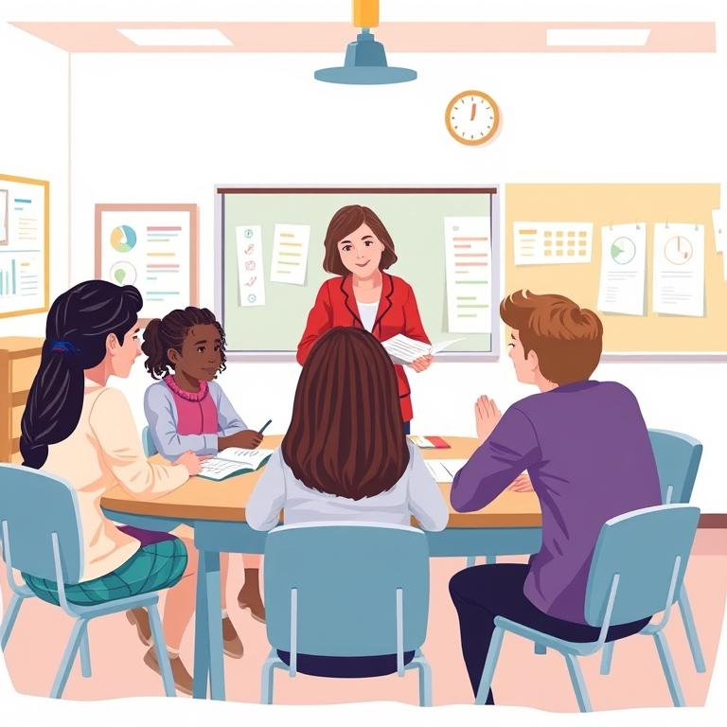
Improved Academic Performance
Parent Management
The Impact of Parent-Teacher Collaboration
Research shows that collaboration between parents and teachers can positively impact a student's academic performance.
Effective communication and partnership between parents and teachers leads to better support for students' educational needs.
Involved parents are more likely to motivate their children, leading to increased interest in learning and improved grades.

Slide 8

Effective Parent Management Skills
Parent Management
Plus tip:
Customize the content by adding specific examples from your experiences with parents or by including additional skills unique to your educational context.
Communication
Collaboration
Respect
Effective parent-teacher partnerships are built on open communication. Set up regular communication channels, such as parent-teacher conferences, email, or phone calls. Be responsive and timely, and keep parents informed about their child's progress.
Be collaborative: Work together to support your child's unique needs. Sharing information about the child's strengths, areas for improvement, and academic progress fosters a team approach.
Be welcoming and positive: When communicating with parents, be warm, encouraging, and make eye contact. Consider cultural differences and be inclusive of those differences.

Slide 9
Strategies for Effective Communication
Effective Parent Management Skills
Plus tip:
You can customize this slide by adding specific communication tools or platforms that your school uses, and by including examples of successful communication strategies you've implemented.
Communicate Regularly
Set up regular communication channels, such as parent-teacher conferences, email, or phone calls. Be responsive and timely, keeping parents informed about their child's progress.
Be Welcoming and Positive
When communicating with parents, be warm and encouraging. Make eye contact to foster a positive interaction.
Share Information
Provide information about the child's strengths, areas for improvement, and academic progress to keep parents engaged.
Consider Cultural Differences
Be aware of the cultural and linguistic differences between families and yourself, and be inclusive of those differences.

Slide 10

Aids and Material Handling
Teaching Aids
Plus tip:
Consider including specific examples of teaching aids that can be utilized in the classroom to illustrate their impact on learning.
Teaching aids are resources used by a teacher that enhance the effectiveness of classroom instruction or boost the interest of the learners. These aids help cater to different learning styles, facilitate understanding of the concepts and enhance the overall learning experience. Proper handling of materials is crucial as it ensures that aids are used effectively and safely, enabling teachers to create an engaging and productive learning environment.

Slide 11
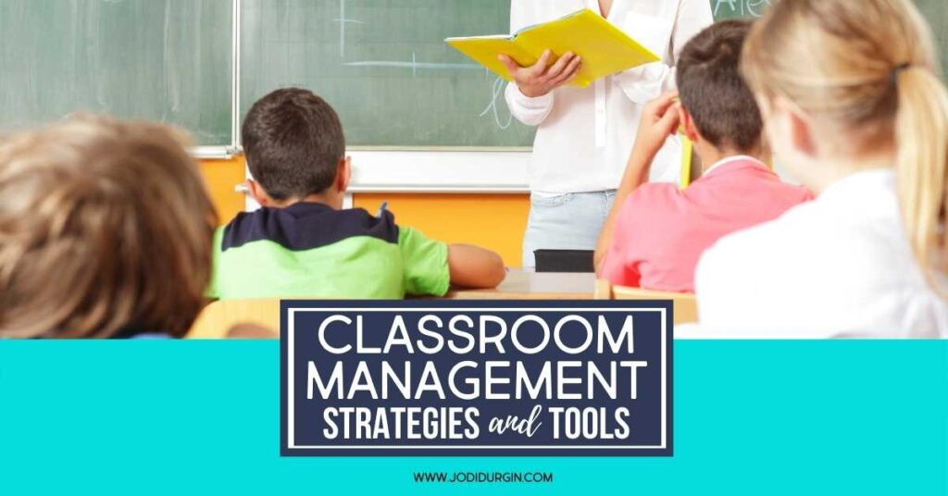
Resource Management in Teaching
Resource Management
Plus tip:
Consider adding specific examples of resource management practices in your school or district to make the content more relatable.
Resource management in teaching involves making a strategic plan for organizing and using school resources. It is crucial for evaluating and maximizing such resources to enhance the educational experience. Effective resource management ensures that materials and tools are used efficiently, enabling teachers to provide the best possible learning environment for students. This involves not only physical resources but also human resources, such as leveraging the skills and strengths of staff and parents to support student learning.

Slide 12
Concluding a Class
Conclusion
Plus tip:
Consider adding specific examples of games or exercises that have worked well in your own classroom experience.
Brainstorming
Provide time for brainstorming or Q&A to encourage student participation and gather feedback.
Mindfulness Exercises
End with a meditation or breathing exercise to help students relax and reflect on their learning.
Mindfulness Exercises
Play a quick game or trivia challenge, and recognize achievements to create a positive and engaging conclusion.

Slide 13
Class Conclusion Techniques
Conclusion
Plus tip:
Consider adding visuals or examples of each technique to enhance engagement. You may also include specific scenarios or anecdotes from your own teaching experience.
Appreciation Circles
Review Action Items
Give students recognition by having an appreciation circle where they can express gratitude towards their peers for their efforts and contributions.
Review and summarize action items discussed during the class to reinforce learning and ensure understanding among students.
Mindfulness Exercises
Celebrate Achievements
End the class with a meditation or breathing exercise to help students relax and reflect on what they have learned.
Recognize and celebrate both individual and collective achievements in class to foster motivation and a sense of accomplishment.

Slide 14
Conclusion
Plus tip:
Feel free to customize the thank you note to include specific acknowledgments for the audience or to add any final thoughts you wish to share.
We appreciate your time and participation in this presentation. Engaging parents effectively is crucial for fostering a supportive environment for children. Together, we can build strong partnerships that enhance child development and academic success. Thank you for your commitment to parent engagement skills!
Thank you for your attention!

Slide 15

MySkool is an inspiration for schools, teachers, parents and students to excel in life. It is a message that ‘good is always appreciated.’ It is a push towards self motivation, an opportunity to see how others are growing and a chance to appreciate fellow human beings.

